Slide 1





Versatile cell for in-situ RXD investigation of solid/liquid interfaces in photo- and electro-chemical conditions
Dr. Axel Wilson
Dr. Hadeel Hussain
Dr. Jörg Zegenhagen
Prof Chris Nicklin
Mr. Immad Nadeem
Prof. Geoff Thornton
Diamond Light Source
University College London
Notes:
I’m going to present the development of a new device available on the I07 beamline at DLS (which is the British national 3rd generation synchrotron) and in partnership with UCL
This device purpose is to allow the combination of SXRD at the interface solid/liquid in photo and/or electrochemical conditions.
After a short introduction I will present the main features of the cell and the technological solution we adopted
I will the name a couple of example where this cell would be a decisive addition
I will finally present the first experiment we did with the cell

Slide 2
Introduction: physico-chemistry of interfaces in ‘real’ conditions
Physico-chemistry of surfaces ⇒ evidence and explain phenomena occurring at surfaces and interfaces
Model conditions
VS
Real conditions
Simplify the interpretation
Theoretically easier to investigate
Make the system compatible with specific investigation method
Closer to development phase
May involve new, complex mechanisms
2
Notes:
One of the objective of surface science is to evidence and explain reactions/phenomena occurring at interfaces
We can however distinguish studies realized on model conditions (in vacuum, at room temperature, at 0K in the case of theoretical studies) or real conditions (atmospheric or high pressure, high temperature)
Working on a model system allow to isolate as much as possible the system and study precisely one given phenomenon and facilitate the interpretation.
In terms of computational science it is sometime necessary to use model conditions to decrease computing time.
Some investigation technique require these condition to operate. XPS and LEED for example have to be realized in vacuum to collect electrons with the analyser, STM is much more stable in vacuum than in atmospheric pressure of reactant.
On the other hand real condition allow to work much closer to what would be the conditions in the development phase of a system.
It may, however, involve additional phenomena/reactions that complexity drastically the interpretation for a give observation

Slide 3
Introduction: physico-chemistry of interfaces in ‘real’ conditions
Physico-chemistry of surfaces ⇒ evidence and explain phenomena occurring at surfaces and interfaces
Model conditions
VS
Real conditions
Pressure gap
Material gap
Simplify the interpretation
Theoretically easier to investigate
Make the system compatible with specific investigation method
Closer to development phase
May involve new, complex mechanisms
→ Near ambient pressure XPS
→ Ambient pressure / liquid phase STM
→ Environmental HRTEM
2
Notes:
In surface science we even have a word to describe the fact of transiting from model conditions to real conditions. Bridging the pressure/material gap.
To overcome this difficulty talented researcher have adapted some of the techniques used on model system with among others NAPXPS, AP LP STM (ambient pressure means here performing STM in a controlled environment) or E-HRTEM where a small cell with gas inlet and outlet is used to separate vacuum from reactive environment.

Slide 4
Introduction: physico-chemistry of interfaces in ‘real’ conditions
Physico-chemistry of surfaces ⇒ evidence and explain phenomena occurring at surfaces and interfaces
Model conditions
VS
Real conditions
Pressure gap
Material gap
Simplify the interpretation
Theoretically easier to investigate
Make the system compatible with specific investigation method
Closer to development phase
May involve new, complex mechanisms
→ Near ambient pressure XPS
→ Ambient pressure / liquid phase STM
→ Environmental HRTEM
Reactions at the solid/liquid interface are difficult to study due to the high absorption of the liquid phase
→ Structural investigation using Surface X-ray Diffraction (ν > 10 keV)
→ Development of a versatile cell for multi environmental purpose
2
Notes:
Solid/liquid interfaces are not compatible with most of the standard investigation technique mentioned previously due to the high absorption of the layer of liquid.
XRD using hard X-ray generated with

Slide 5
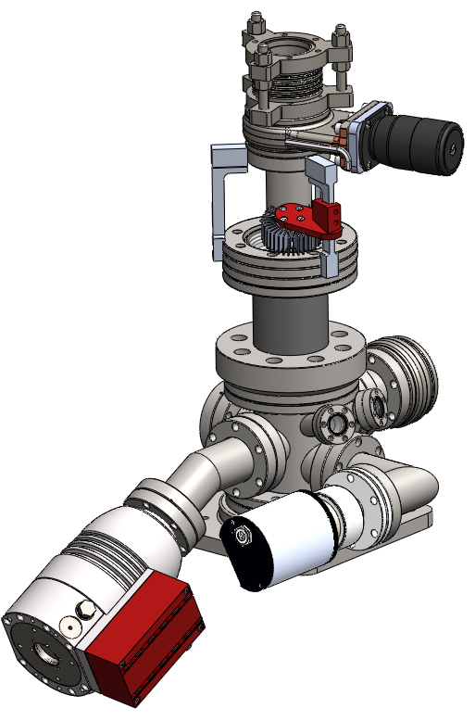
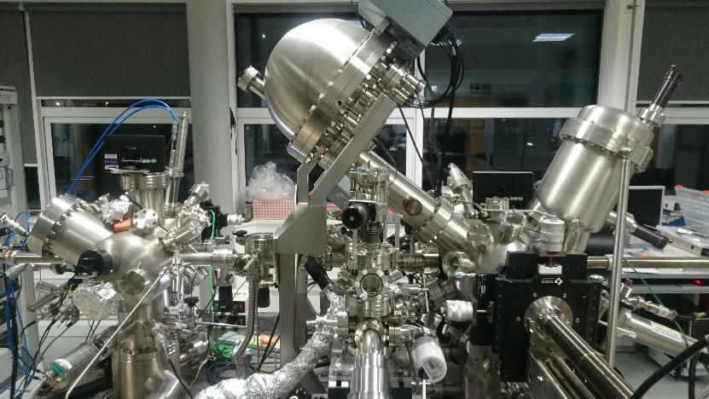
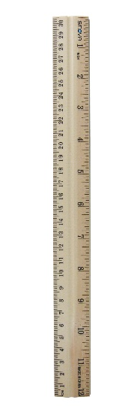
XRD photo-electrochemical cell
Main features:
UHV preparation, pre-characterisation and transfer to I07 diffractometer
30 cm
XRD PECcell body
→ Preparation using standard UHV procedures
→ Pre-characterisation using VT-STM, monochromated XPS and LEED
→ Allows to perform offline experiments
3
Notes:
I will now present the XRD photo-electrochemical cell insisting on the features available on the latest version.
The first important feature is that the cell is UHV compatible and can be mounted directly on a UHV apparatus.

Slide 6
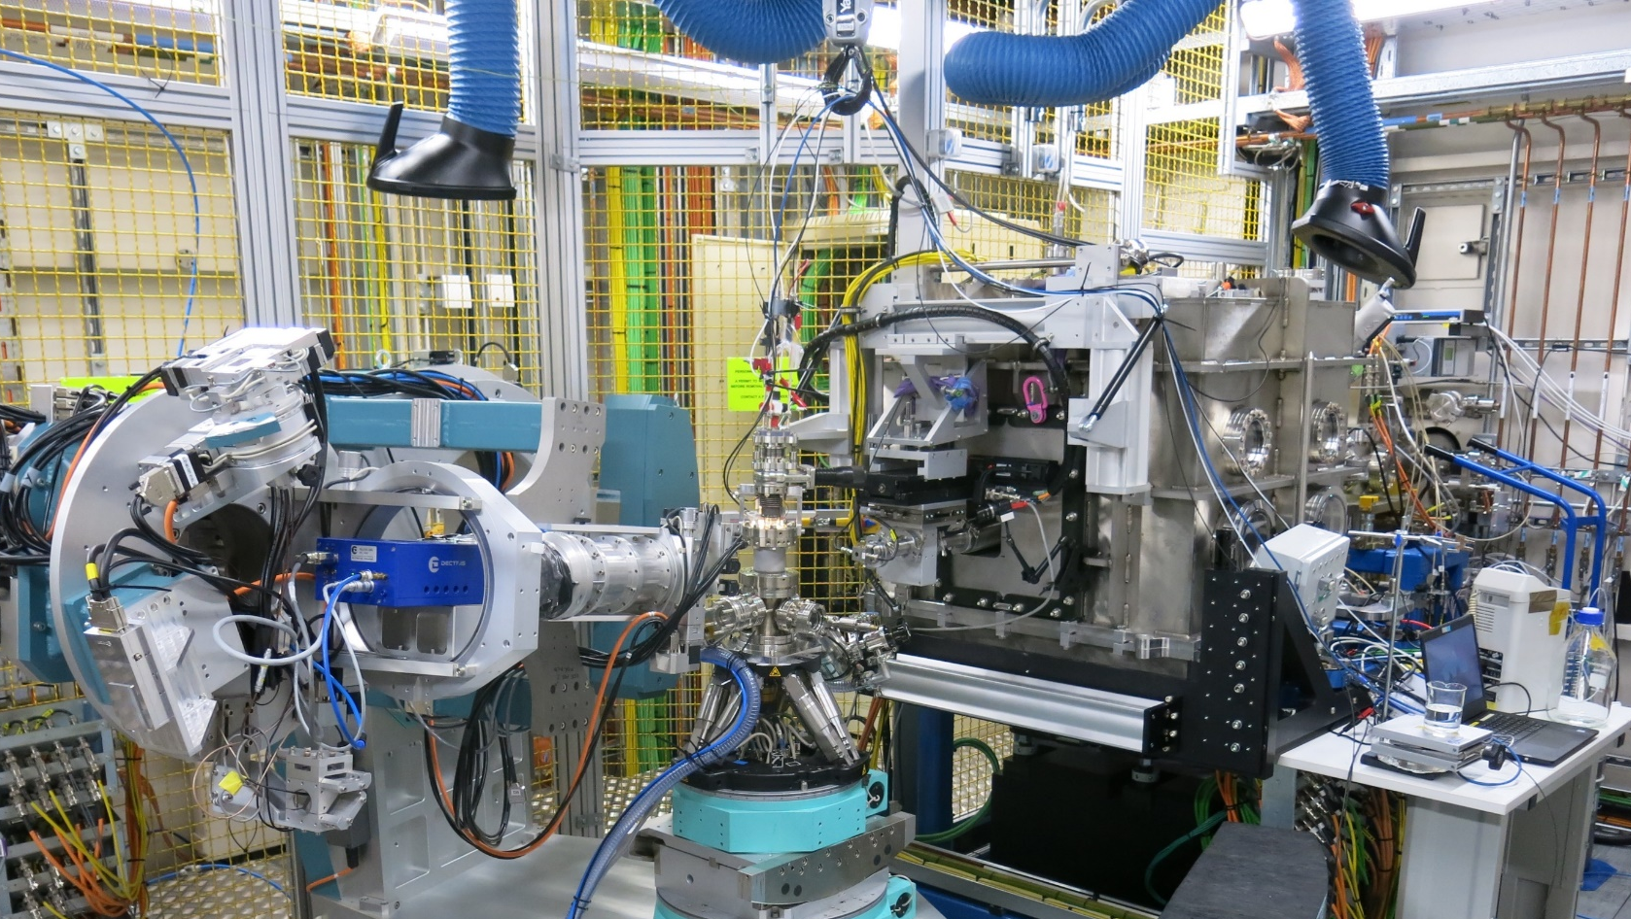
XRD photo-electrochemical cell
Main features:
UHV preparation, pre-characterisation and transfer to I07 diffractometer
Beryllium
cylinder
PECcell body
→ Preparation using standard UHV procedures
→ Pre-characterisation using VT-STM, monochromated XPS and LEED
→ Allows to perform offline experiments
3

Slide 7
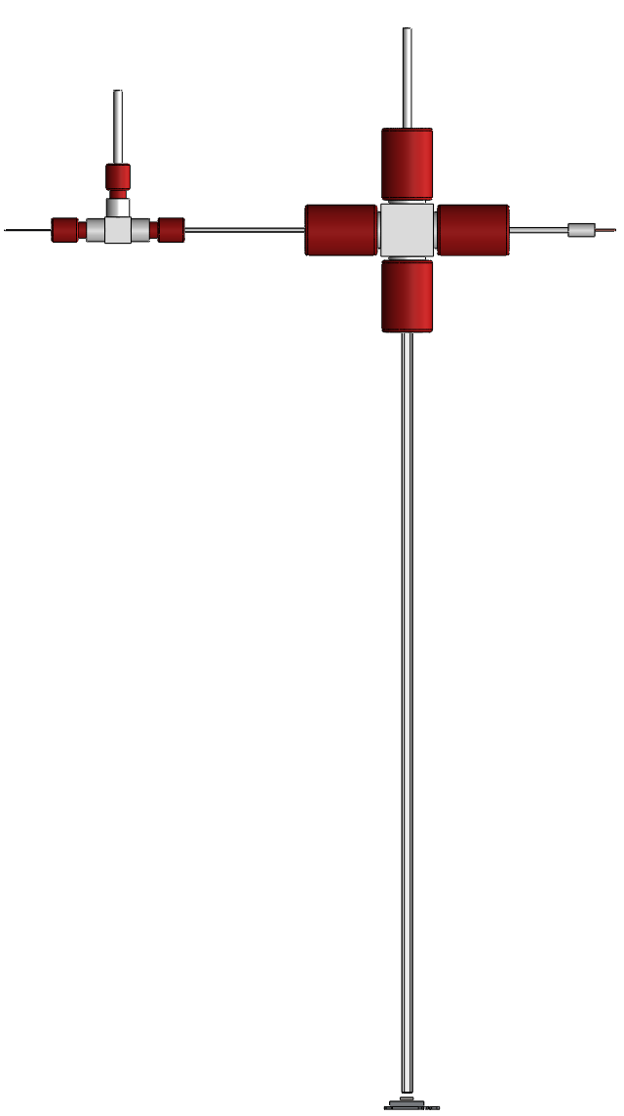
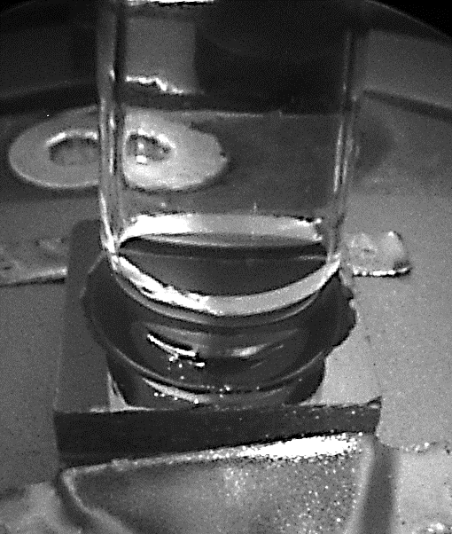
XRD photo-electrochemical cell
Main features:
UHV preparation, pre-characterisation and transfer to I07 diffractometer
Formation of a solid/liquid interface
Electrolyte in
Electrolyte out
Introduction of the liquid delivery device
Liquid is handled using a dual syringe pump
→ Dispense fresh electrolyte
→ Pick-up from the interface
→ Possibility to flow the electrolyte
Interface monitored using an endoscope and camera
Sample
4
Design based on F. U. Renner, Y. Gruender & J. Zegenhagen, Rev. Sci. Inst., 78, 2007

Slide 8
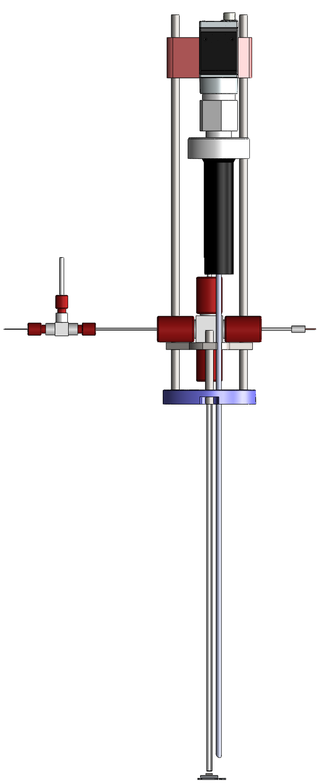
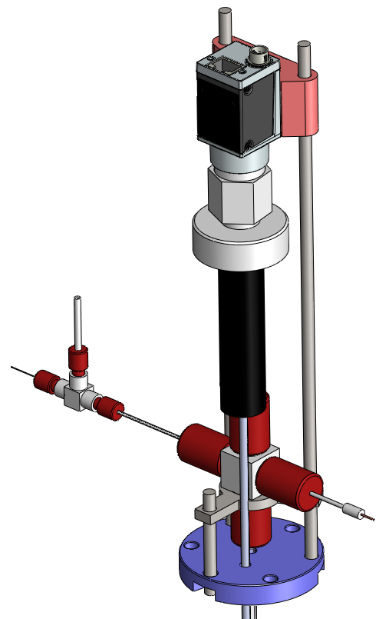
XRD photo-electrochemical cell
Camera
Main features:
UHV preparation, pre-characterisation and transfer to I07 diffractometer
Formation of a solid/liquid interface
Application of an external potential
Platinum electrode
The sample (working electrode) is isolated from ground
A platinum electrode is located inside the inner capillary
A reference electrode is located over the capillaries
Cyclic voltammetry and chronoamperometry with Ivium potentiostat
Reference
electrode
Working electrode
5
Design based on F. U. Renner, Y. Gruender & J. Zegenhagen, Rev. Sci. Inst., 78, 2007

Slide 9
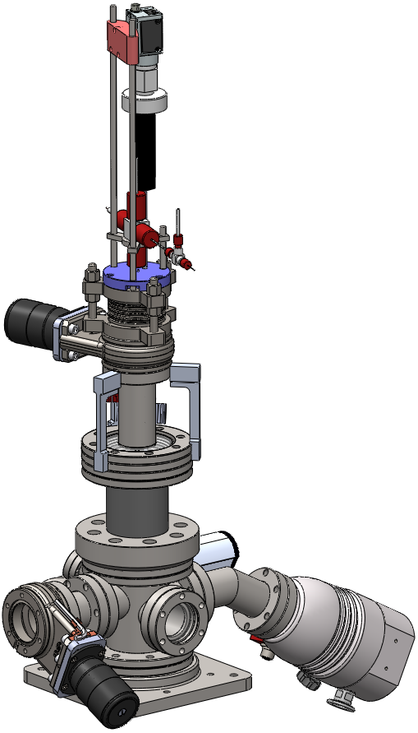
XRD photo-electrochemical cell
Main features:
UHV preparation, pre-characterisation and transfer to I07 diffractometer
Formation of a solid/liquid interface
Application of an external potential
The sample (working electrode) is isolated from ground
A platinum electrode is located inside the inner capillary
A reference electrode is located over the capillaries
Cyclic voltammetry and chronoamperometry with Ivium potentiostat
5

Slide 10
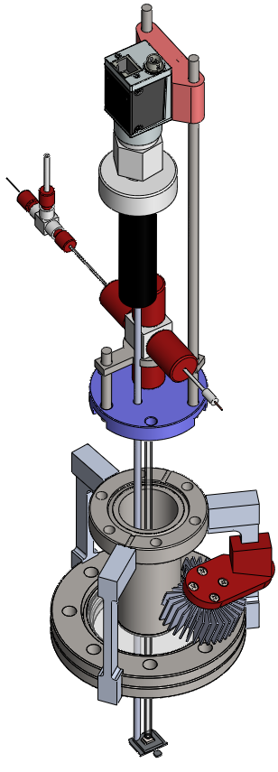
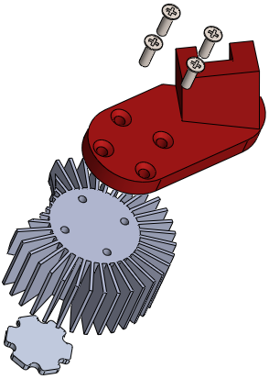
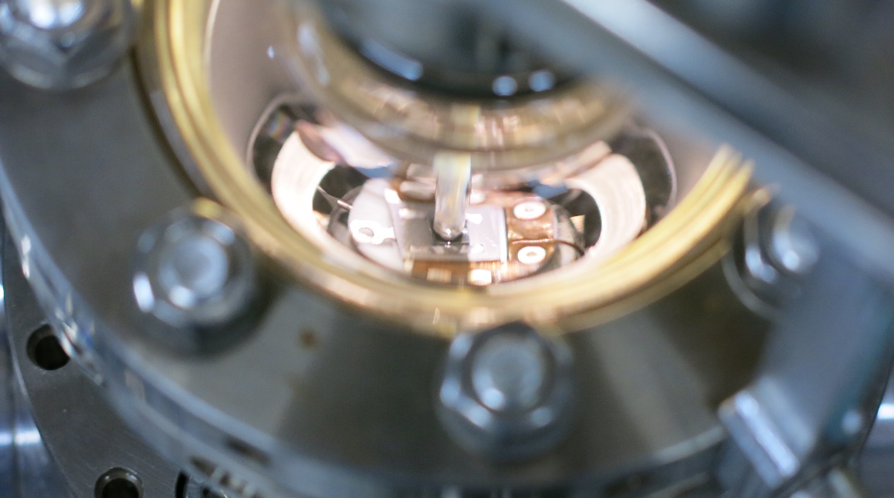
XRD photo-electrochemical cell
Main features:
UHV preparation, pre-characterisation and transfer to I07 diffractometer
Formation of a solid/liquid interface
Application of an external potential
Illumination of the sample
The sample can be illuminated trough the glass-to-metal reducer
Intense LED-UV light (365nm 10mA.cm⁻²) is available at the moment
Cooling block
UV LED
6

Slide 11
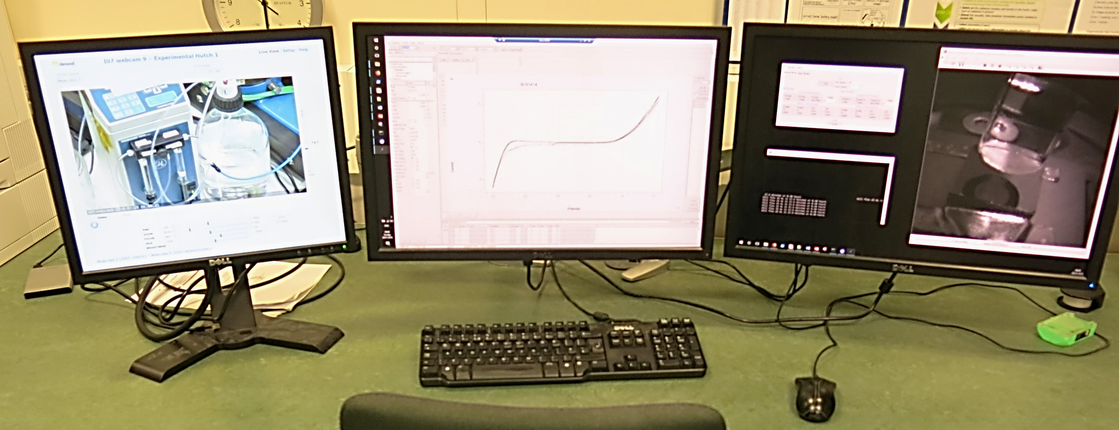
XRD photo-electrochemical cell
Main features:
UHV preparation, pre-characterisation and transfer to I07 diffractometer
Formation of a solid/liquid interface
Application of an external potential
Illumination of the sample
Operate entirely from the control cabin of the beamline
Syringe status
Potentiostat software
Syringe control
Interface monitor
A unique computer controlling the cell can be remote accessed
→ Syringe pump
→ Potentiostat
→ UV illumination system
→ Monitoring camera
7

Slide 12
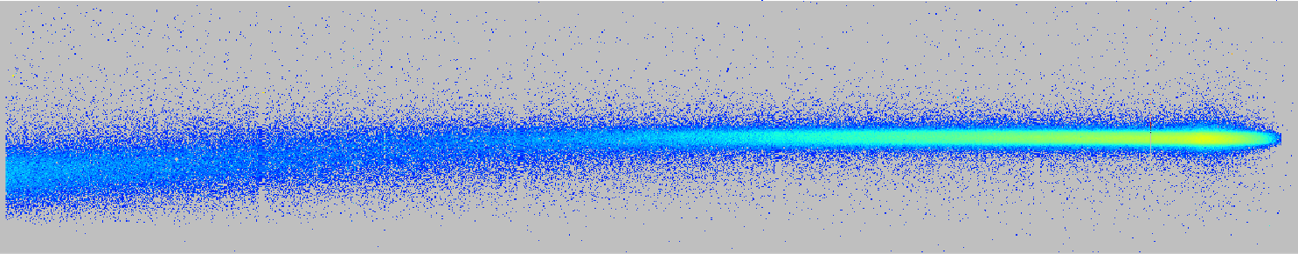

Surface X-ray Diffraction: basics
Experience realized at grazing incidence close to the critical angle to improve surface sensitivity
2D detector
Surface X-Ray Diffraction (SXRD)
Structure of crystalline surfaces
Displacements, roughness, surface relaxation
Grazing Incidence X-ray Diffraction (GIXD)
Structure of nano-objects
Size, lattice parameters, strains, domains
Grazing Incidence Small Angle X-ray Scattering (GISAXS)
Morphology of nanostructures
Size, size distribution, shape
Particle-particle pair correlation function
SXRD
& GIXD
slits
α_{f}
2θ
k_{f}
2D detector
Q⊥
q_{z}
ω
q_{y}
D
Q//
k_{i}
α_{f}
δ
α_{i}
2θ
h
q_{x}
GISAXS
d
HDR, Giles Renaud, CEA, 2011
8

Slide 13
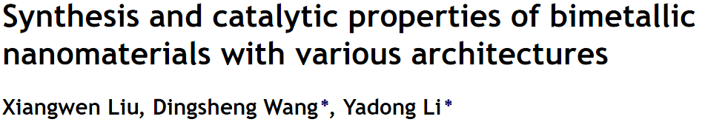
Surface X-ray Diffraction: example of application
In-situ growth of bimetallic NPs using deposition precipitation
Nano Today 7, 2012
9

Slide 14
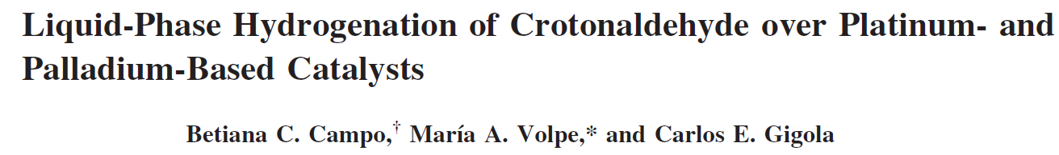
Surface X-ray Diffraction: example of application
In-situ growth of bimetallic NPs using deposition precipitation
Nano Today 7, 2012
Structural evolution of the interface during solid/liquid (photo-)catalysis: activation and deactivation
Industrial & Engineering Chemistry Research 48, 2009
9

Slide 15
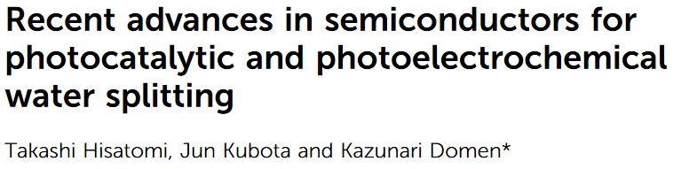
Surface X-ray Diffraction: example of application
In-situ growth of bimetallic NPs using deposition precipitation
Nano Today 7, 2012
Structural evolution of the interface during solid/liquid (photo-)catalysis: activation and deactivation
Industrial & Engineering Chemistry Research 48, 2009
Operando evolution of a metal-oxide electrode during photo-electrocatalytic water splitting
Chemical Society review 43, 2014
9

Slide 16
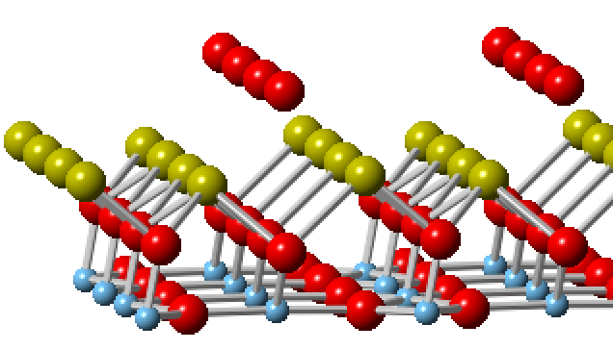
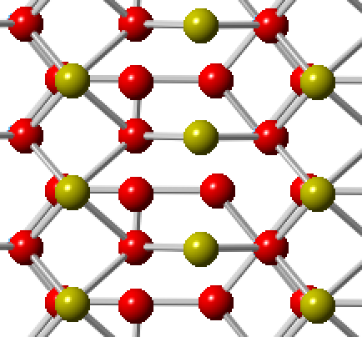
Solid/liquid interfaces TiO₂/NaOH(0.1M) and TiO₂/HCl(0.1M)
Sample prepared in UHV, characterized using STM, LEED and XPS
Transferred in UHV to the diffractometer, characterized using SXRD
Vented to N₂ before formation of the interfaces
Rutile TiO₂(110)/NaOH(0.1M)
Rutile TiO₂(110)/HCl(0.1M)
O_{A}
Na_{B}
O_{T}
Na_{T}
O_{2c}
Ti_{5c}
→ A monolayer of Terminal O (O_{t}) species exist.
→ A monolayer of Na_{T} which interacts with four O, adsorbs in a tetra-dentate Site.
→ A monolayer of Na_{B} which interacts with four O, adsorbs in a tetra-dentate Site.
→ A monolayer of O species above the Na exists.
10

Slide 17
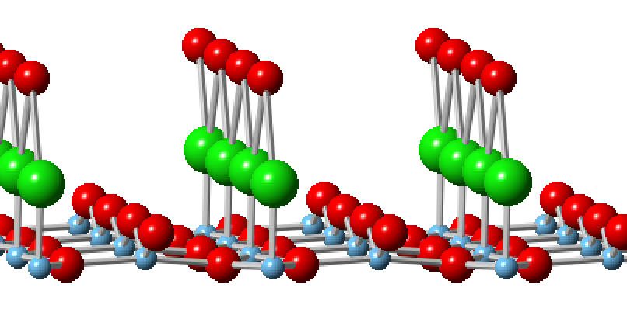
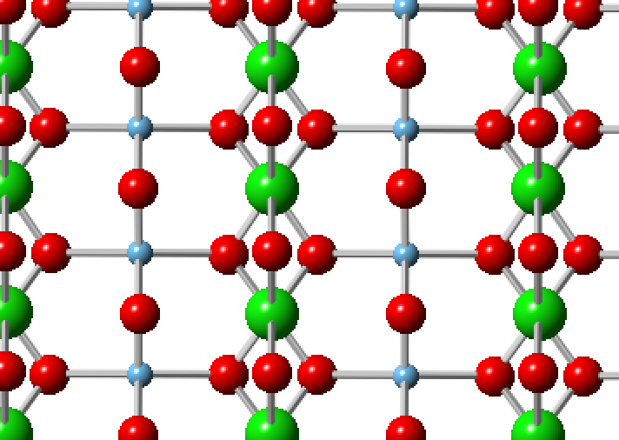
Solid/liquid interfaces TiO₂/NaOH(0.1M) and TiO₂/HCl(0.1M)
Sample prepared in UHV, characterized using STM, LEED and XPS
Transferred in UHV to the diffractometer, characterized using SXRD
Vented to N₂ before formation of the interfaces
Rutile TiO₂(110)/NaOH(0.1M)
Rutile TiO₂(110)/HCl(0.1M)
O_{A}
Na_{B}
O_{T}
O_{A}
Na_{T}
Cl_{T}
O_{2c}
Ti_{5c}
O_{2c}
Ti_{5c}
→ A monolayer of Terminal O (O_{t}) species exist.
→ A monolayer of Na_{T} which interacts with four O, adsorbs in a tetra-dentate Site.
→ A monolayer of Na_{B} which interacts with four O, adsorbs in a tetra-dentate Site.
→ A monolayer of O species above the Na exists.
→ A monolayer of Terminal Cl (Cl_{t}) species exist.
→ A monolayer of O species above the Cl exists.
10

Slide 18
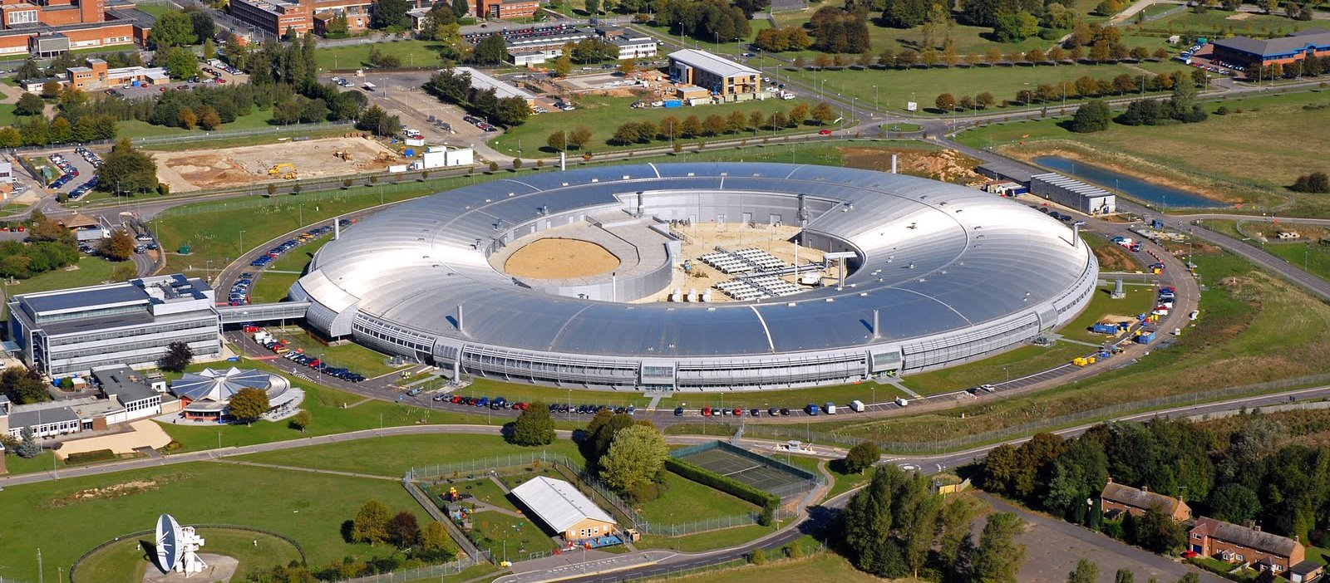
Looking forward to seeing you at Diamond Light Source, Oxfordshire, UK!
Acknowledgement:
Immad Nadeem (Phd student)
Dr. Hadeel Hussain (Post-doc)
Prof. Geoff Thornton (UCL)
Adam Warne (Technician)
For any question regarding the XRD photo-electrochemical cell
Dr. Axel Wilson (axel.wilson@diamond.ac.uk)
For any question about I07 beamline and beamtime application
Prof. Chris Nicklin (I07 principal beamline scientist, chris.nicklin@diamond.ac.uk)

